Slide 1
Hospital Management System
Submitted by -
Mopidevi Deepthi

Slide 2
Introduction
Hospital Management System brings together all the information and processes of a hospital, in a single platform.
Hospital management system is the inevitable part of the lifecycle of the modern medical institution. It automates numerous daily operations and enables smooth interactions of the users.
The system automatically generates a highly-efficient process and makes it quick.

Slide 3
Project Briefing
The application allows
- Patient to book their appointments and can view.
- Doctors look into the appointments they had appointed.
Doctors posts and gets the prescription.
Patients gets the prescription without any delay.
One of the main requirement here is Secuity.

Slide 4
Microservice
Single microservice
Consists of two schemas
- Appointment
- Prescription
Patient can book an appointment by passing required details.
Ex : localhost:8083/patient/bookappointment
Based on patient situation, a prescription can post by doctor.
Ex : localhost:8083/prescription/save

Slide 5
Doctor and patient can view their respective appointments.
Ex : localhost:8083/doctor/appointments
Ex : localhost:8083/patient/myappointments
Finally, patient receives his prescription.
Ex : localhost:8083/prescription/view

Slide 6
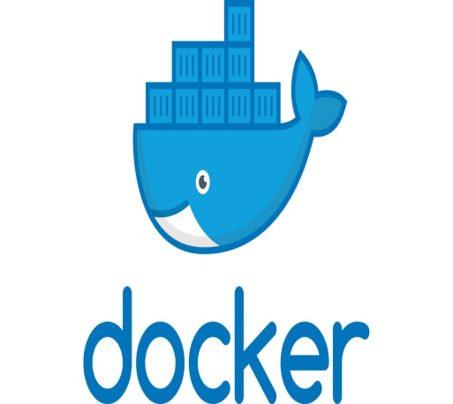
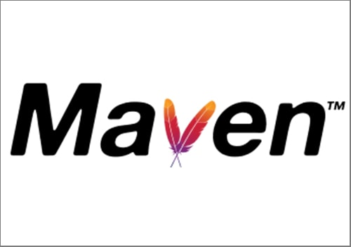
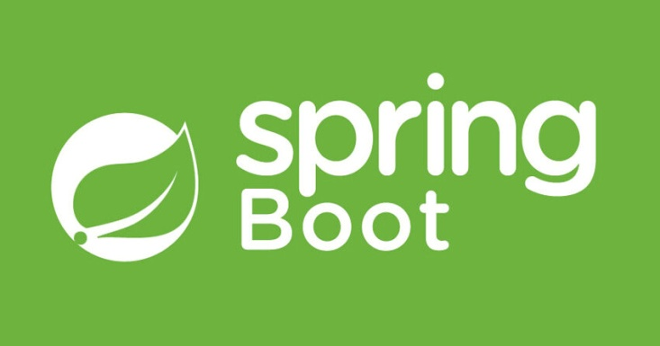
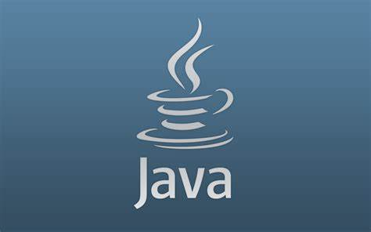

Tools Used
Apache Maven
Java
Docker
Spring Boot
Mongo DB

Slide 7
Apache Maven
Maven is a project management and comprehension tool that provides developers a complete build lifecycle framework. Development team can automate the project's build infrastructure in almost no time as Maven uses a standard directory layout and a default build lifecycle.
Maven uses Convention over Configuration, which means developers are not required to create build process themselves.
Developers do not have to mention each and every configuration detail. Maven provides sensible default behavior for projects.

Slide 8
Docker
Docker is an open source platform that enables developers to build, deploy, run, update and manage containers—standardized, executable components that combine application source code with the operating syste libraries and dependencies required to run that code in any environment.
Docker container starts with a simple text file containing instructions for how to build the Docker container image.
Docker images contain executable application source code as well as all the tools, libraries, and dependencies that the application code needs to run as a container.

Slide 9
Some docker commands –
mvn install dockerfile:build
docker ps
docker images
docker-compose –f docker-compose-mongo.yml up –d
Docker image –
Ex: deepthi007/hospital-management-system:0.0.1-SNAPSHOT

Slide 10
Java
Java is a programming language and a platform. Java is a high level, robust, object-oriented and secure programming language.
A general-purpose programming language made for developers to write once run anywhere that is compiled Java code can run on all platforms that support Java.

Slide 11
Spring Boot
Spring Boot is a project that is built on the top of the Spring Framework. It provides an easier and faster way to set up, configure, and run both simple and web-based applications.
It is a Spring module that provides the Rapid Application Development feature to the Spring Framework. It is used to create a stand-alone Spring-based application that you can just run because it needs minimal Spring configuration.
In Spring Boot, there is no requirement for XML configuration (deployment descriptor). It uses convention over configuration software design paradigm that means it decreases the effort of the developer.

Slide 12
Mongo db
MongoDB is a cross-platform, document oriented database that provides, high performance, high availability, and easy scalability. MongoDB works on concept of collection and document.
Collection is a group of MongoDB documents. It is the equivalent of an RDBMS table. A collection exists within a single database. Collections do not enforce a schema.
A document is a set of key-value pairs. Documents have dynamic schema. Dynamic schema means that documents in the same collection do not need to have the same set of fields or structure, and common fields in a collection's documents may hold different types of data.

Slide 13

Postman
Postman is an API platform for building and using
APIs. Postman simplifies each step of the API lifecycle and streamlines collaboration so you can create better APIs—faster. A comprehensive set of tools that help accelerate the API Lifecycle - from design, testing, documentation, and mocking to discovery.

Slide 14
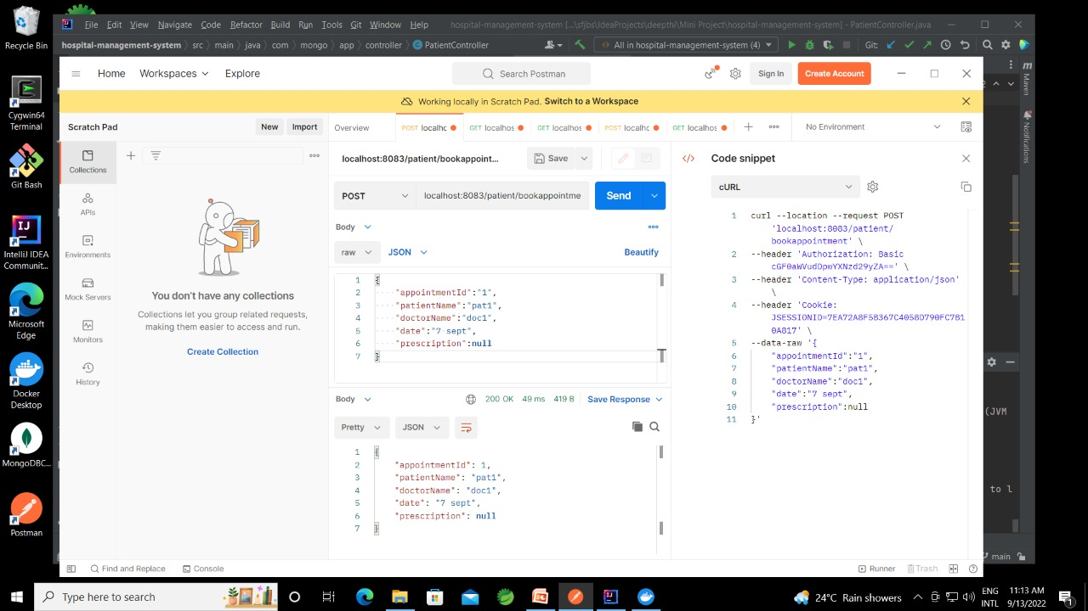

Slide 15
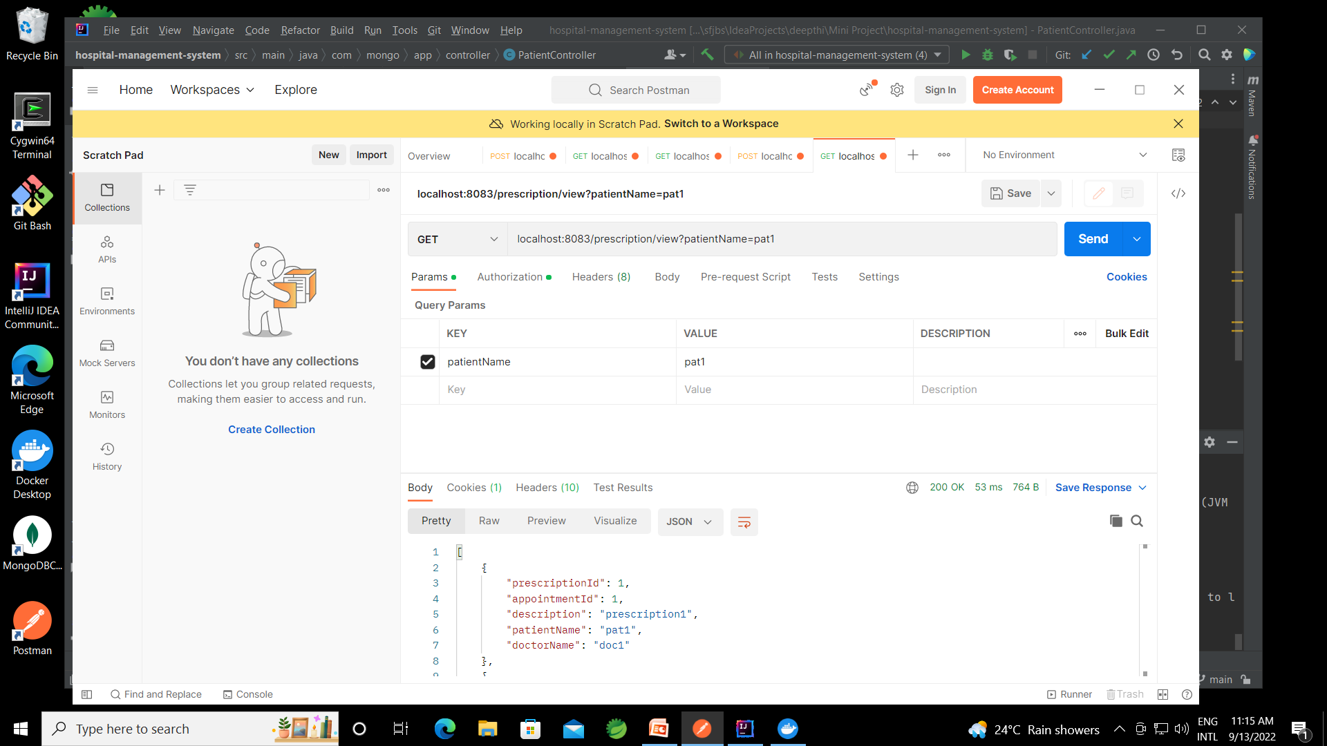

Slide 16
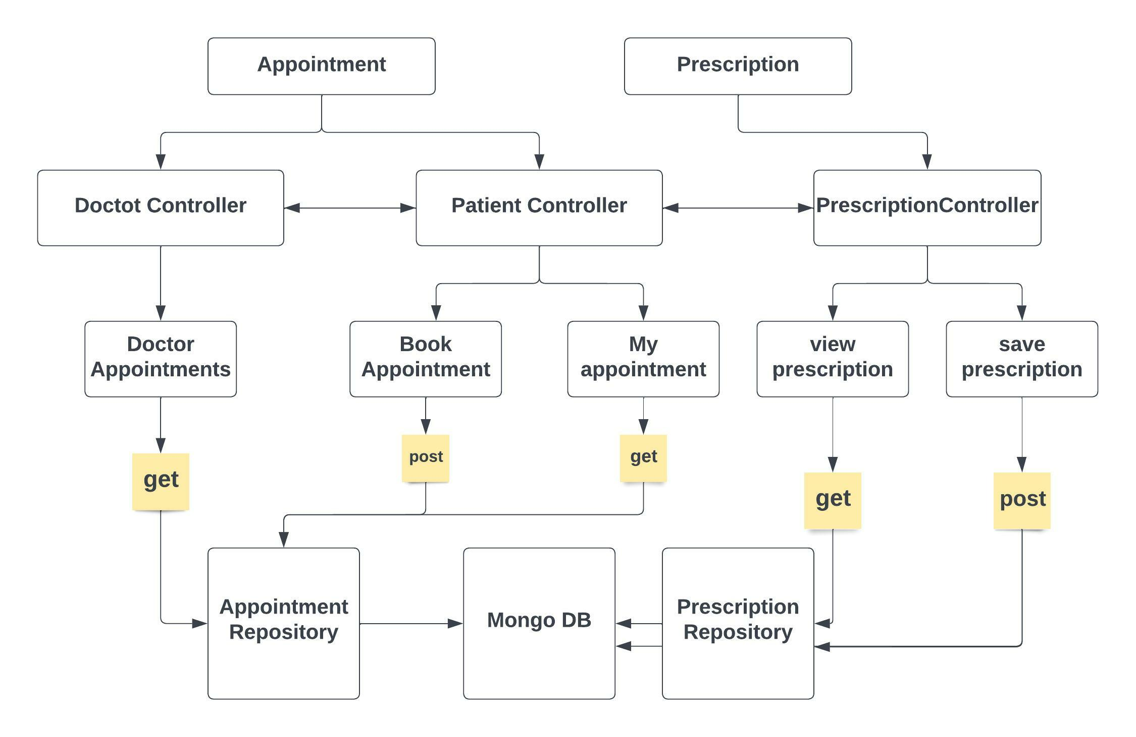
Architecture

Slide 17
Use Case
Use case 1
Patients to keep thier records of all appointments.
Also useful for the patients who are unable to go to hospital.
Use case 2
Hospital management to have records of all the appointments as well as prescription given by doctor along with patient details.

Slide 18
Testing
The tool used for testing is SonarLint.
The code coverage is-
Class - 100%
Method - 81%
Line - 86%

Slide 19
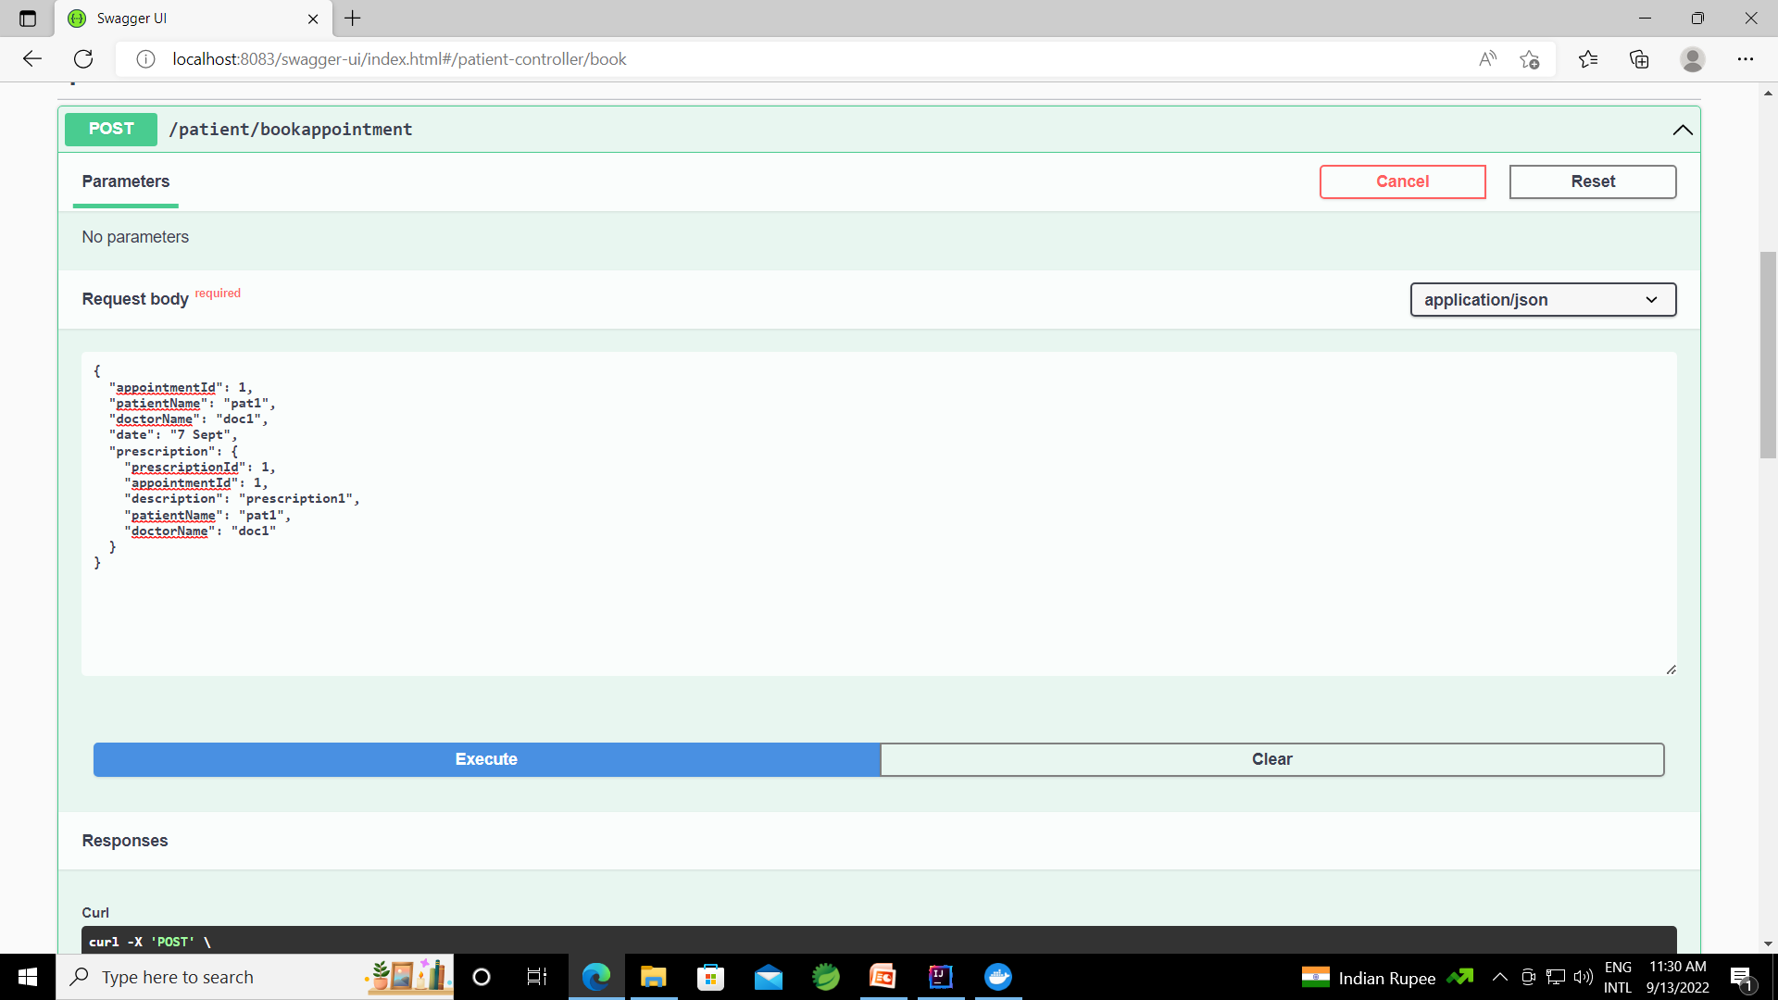
Swagger

Slide 20
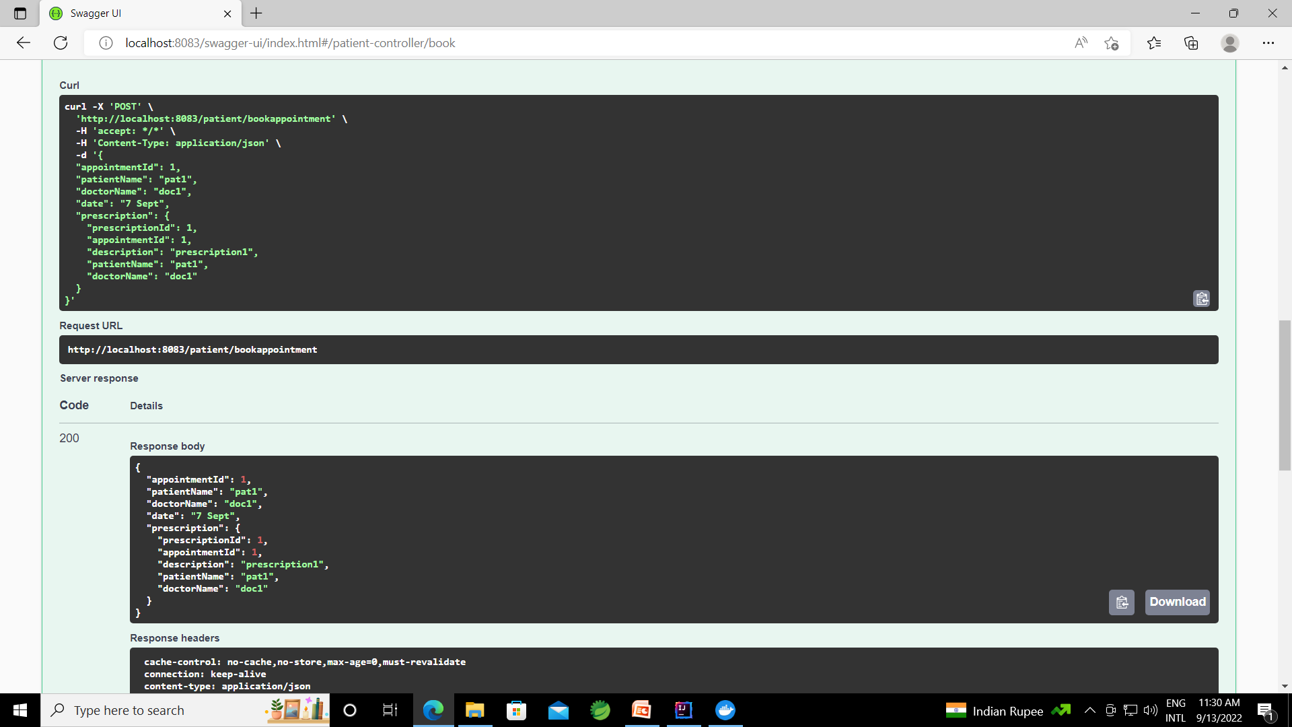

Slide 21


